Slide 1


Onboarding
Confidential
Created by ex-McKinsey, Deloitte & BCG Management Consultants

Slide 2

Table of Contents
1
Content overview
2
How to easily leverage our Toolkits to create your own deliverables
3
How to easily translate our Toolkits in all languages

Slide 3


Aurelien Domont
Domont Consulting CEO
Ex-Deloitte Management Consultant
Improve the growth and efficiency of your organization by leveraging the know-how of ex-McKinsey, Deloitte & BCG Management Consultants without breaking your budget.
Imagine having a team of ex-McKinsey, Deloitte and BCG Management Consultants at your disposal at any time of the day to help you solve your business problems and improve the growth and efficiency of your organization. How much more confident would you be about the future performance of your organization and your own career? How much more time could you save?
If you’ve ever tried solving business problems that you haven’t encountered before, you know how frustrating it can be to start from scratch. And even then, you still aren’t sure if what you’re doing is going to end up wasting your time and money. Having someone by your side who has already solved these business problems would be a huge help. That’s why businesses hire management consultants for support in the first place.
The only problem is that hiring a couple of tier-1 Consultants for a management consulting project would cost you at least $300,000! Not every business or team can afford this.
I wanted to do something about this because I believe everyone deserves to receive high-value business guidance, regardless of their budget!
That’s why I’ve teamed up with other ex-McKinsey, Deloitte and BCG Consultants to create all the Business & Consulting Toolkits required to solve your business problems and improve the growth and efficiency of your organization! And it's all on our website www.domontconsulting.com and in the Gold Access.
Whether you're an executive, entrepreneur or consultant from a small or large organization, you can now leverage the know-how and best practices of our ex-McKinsey, Deloitte & BCG Management Consultants without breaking your budget.
Join the 200,000+ Executives, Consultants & Entrepreneurs already leveraging our Management Consulting Toolkits to improve the performance of their organization and boost their own career.

Slide 4


















Our ex-McKinsey, Deloitte & BCG Consultants have created 19 Management Consulting Toolkits
1. Corporate & Business Strategy Toolkit
2. Management Consulting Toolkit
3. Operating Model & Organization Design Toolkit
4. Digital Transformation Toolkit
5. Change & Project Management Toolkit
6. Strategic Planning Toolkit
7. Human Resources & Talent Management Toolkit
8. Mergers & Acquisitions Toolkit
9. Post Merger Integration Toolkit
10. Sales, Marketing & Communication Strategy Toolkit
11. Business Plan & Entrepreneurship Toolkit
12. Supply Chain Strategy Toolkit
13. Lean 6 Sigma Toolkit
14. Risk Management Toolkit
15. Leadership Development Toolkit
16. Financial Modeling, Planning & Analysis Toolkit
17. Customer Experience Strategy & Design Thinking Toolkit
18. Data Analytics Strategy Toolkit
19. Warren Buffet Value Investing Strategy Toolkit
Need another Toolkit?
Let us know by sending an email at support@domontconsulting.com

Slide 5








Each Management Consulting Toolkit includes:
Best practices
Frameworks
What’s inside our Toolkits?
Advise from tier-1 management consultants
Tools
Real-life examples
Templates
Video Training
Step-by-step tutorials

Slide 6









Key Benefits of our Management Consulting Toolkits
Improve the growth & efficiency of your organization by leveraging Management Consulting Toolkits created by ex-McKinsey, Deloitte & BCG Consultants.
Make a great investment for your career & organization. It cost us US$8M+ over the past 10 years to create all our Toolkits. Get them for a fraction of this cost.
Get a competitive advantage. It’s like hiring Management Consultants to create all the practical Frameworks, Tools & Templates you need.
Get the job done quicker and never start from scratch again with our ready-made and fully editable Frameworks, Tools & Templates in Powerpoint & Excel.
Don't reinvent the wheel. We have already worked 30,000+ hours over the past 10 years to create all the Management Consulting Toolkits you need.
Improve the capabilities of your organization by learning how the Fortune 100 and Global Consulting Firms do it.
Decrease your costs. Hiring tier-1 Consultants for a project would cost you $300k+. Way more expensive than our Toolkits, which will last you a lifetime!
Become your organization’s subject matter expert and impress your stakeholders with world-class approaches to resolve common business problems.
Get free support and advice from our ex-McKinsey, Deloitte & BCG Management Consultants.

Slide 7
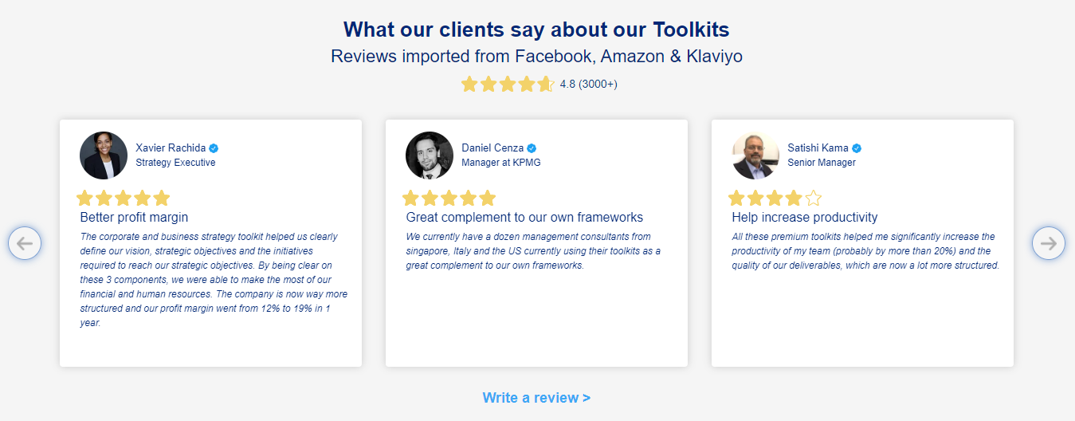
What our clients say about our Toolkits Reviews imported from Facebooks, Amazon and Klaviyo
See more reviews >

Slide 8

Join the 200,000+ Executives, Consultants & Entrepreneurs already leveraging our Business & Consulting Toolkits to improve the performance of their organization and boost their own career.
Trusted by small and large organizations
Customer satisfaction
4.8
Number of countries leveraging our Business & Consulting Toolkits
1all
Number of professionals leveraging our Business & Consulting Toolkits
200,000+
Daily rate of our ex-McKinsey, Deloitte and BCG Management Consultants
$3k-$4k

Slide 9

Interested in more than 1 Toolkit? Access all our Toolkits for half the price with our Gold Access
Gold Access
Click here to learn more

Slide 10






Need additional help on top of our Management Consulting Toolkits? Send us a brief and we’ll find you the right talent from our network of 500 tier-1 Management Consultants (the average daily rate is $3k)
Click here to send us a Project Brief

Slide 11
Table of Contents
1
Content overview
2
How to easily leverage our Toolkits to create your own deliverables
3
How to easily translate our Toolkits in all languages

Slide 12
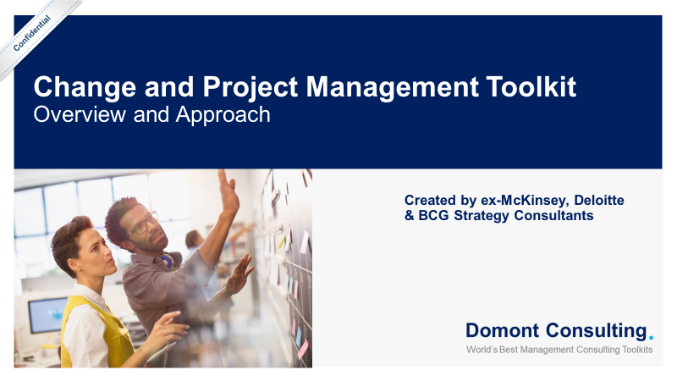
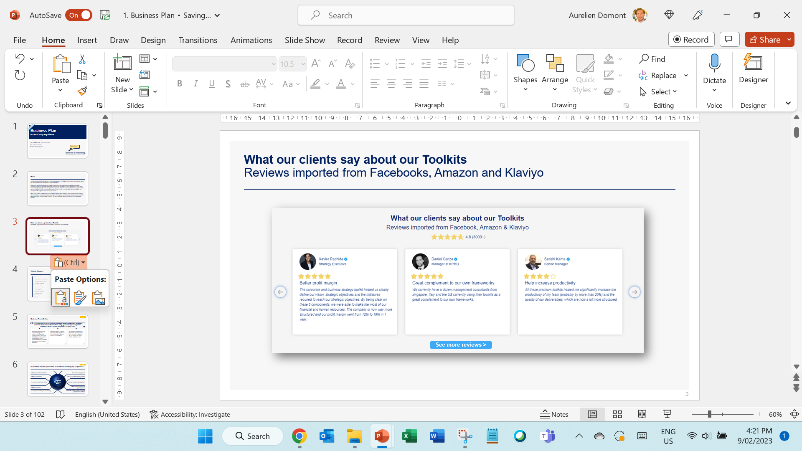
To create their own deliverables, our clients usually choose one of these 2 options
1. Directly using our deliverables
2. Copy pasting our deliverables
Open a deliverable
Delete our logo
Insert your own logo
Select the slides you want to copy.
Right-click on your mouse and then select “Copy” (or press CTRL+C if you have a PC).
Paste the slides into your own presentation.
Click on the “Paste Options” drop-down list, which will automatically appear at the bottom of the slides, and select either option 1 (“Use destination theme”) if you want to use your own formatting, or option 2 (“Keep source formatting”) if you want to use our formatting:
Delete this logo and insert your own logo
“Paste Options” dropdown list

Slide 13
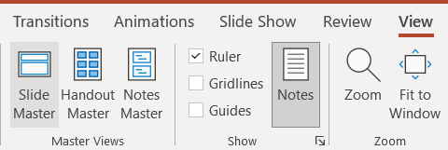
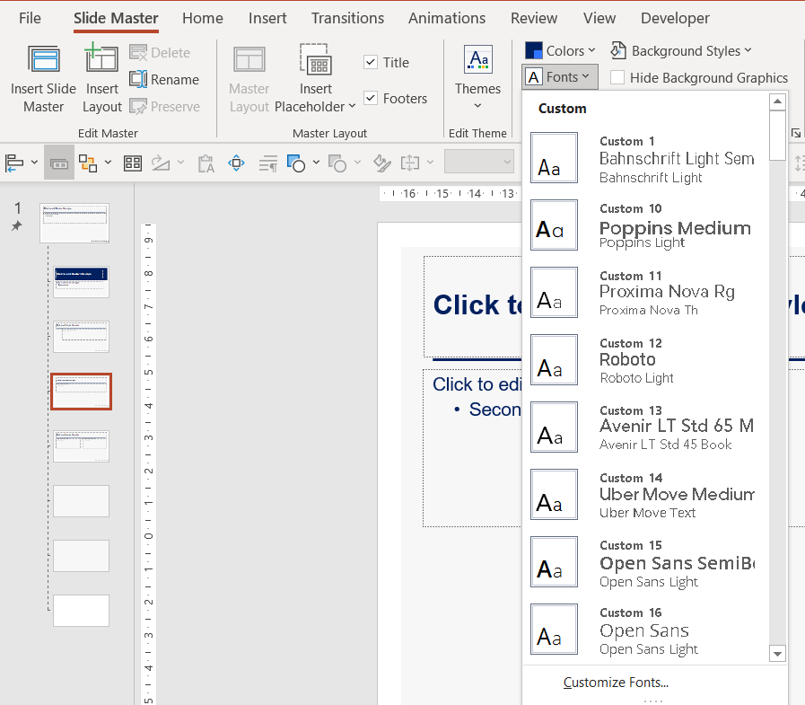
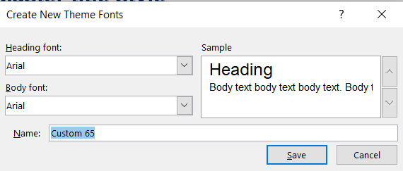
You can change the font type in the Slide Master in 3 steps
1
View → Slide Master
2
Font → Customize Fonts…
3
Enter the preferred font type and Save

Slide 14
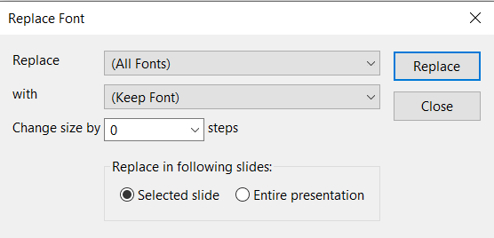
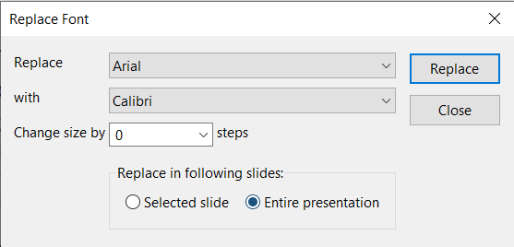
You can also use the “Replace Fonts” option
1
Home → Replace → Replace font
2
Enter the font to be replaced in “Replace” and the preferred font type in “with”
3
Click “Entire presentation” to change the font in the entire document and click Replace

Slide 15
Table of Contents
1
Content overview
2
How to easily leverage our Toolkits to create your own deliverables
3
How to easily translate our Toolkits in all languages

Slide 16


To instantly translate our Toolkits, our clients usually choose the world’s best AI translators in the world: Deepl Translator or Microsoft Translator
Deepl Translator
Microsoft Translator
With Deepl Translator, you can easily and instantly translate an entire document in 30+ languages. All you need to do is go on their website https://www.deepl.com/translator, and drag and drop your Powerpoint or Word document.
We indirectly pay for Deepl.com by providing you a US $50 discount, which you can use to purchase our Toolkits. This discount will cover the cost of Deepl.com. To get this US $50 discount, enter this discount code at checkout: DEEPL$50DISC
With Microsoft Translator, you can easily and instantly translate our Toolkits in all languages.
Microsoft Translator is free and directly available within Powerpoint and Excel.
It uses Neural Machine Translation (NMT), which is the new standard for high-quality AI-powered machine translations.

Slide 17
Let’s first zoom on Deepl Translator
Deepl Translator
Microsoft Translator
With Deepl Translator, you can easily and instantly translate an entire document in 30+ languages. All you need to do is go on their website https://www.deepl.com/translator, and drag and drop your Powerpoint or Word document.
We indirectly pay for Deepl.com by providing you a US $50 discount, which you can use to purchase our Toolkits. This discount will cover the cost of Deepl.com. To get this US $50 discount, enter this discount code at checkout: DEEPL$50DISC
With Microsoft Translator, you can easily and instantly translate our Toolkits in all languages.
Microsoft Translator is free and directly available within Powerpoint and Excel.
It uses Neural Machine Translation (NMT), which is the new standard for high-quality AI-powered machine translations.

Slide 18
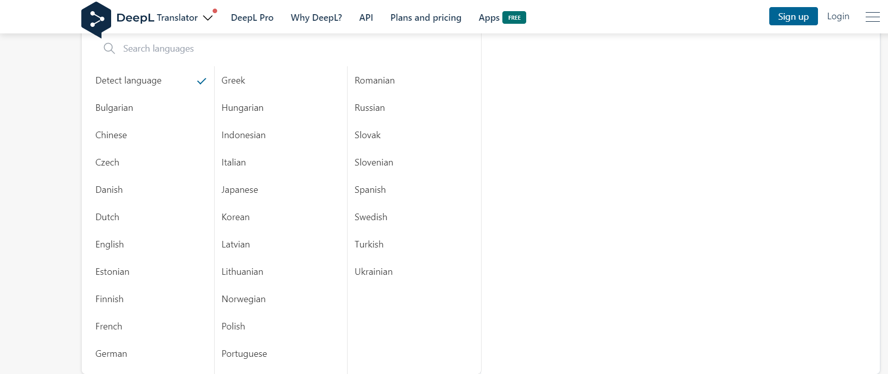
You can translate our Toolkits into 30+ languages using Deepl Translator

Slide 19
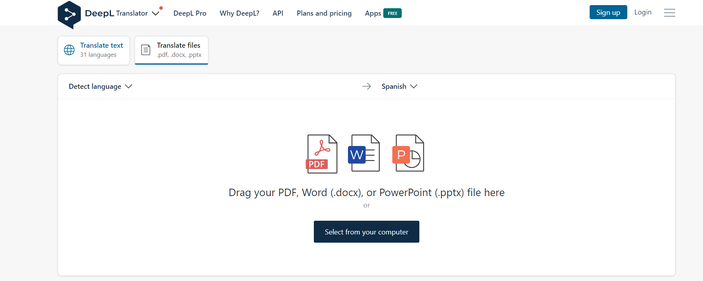
All you need to do is drag and drop your Powerpoint, Word or PDF document

Slide 20
Let’s now zoom on Microsoft Translator
Deepl Translator
Microsoft Translator
With Deepl Translator, you can easily and instantly translate an entire document in 30+ languages. All you need to do is go on their website https://www.deepl.com/translator, and drag and drop your Powerpoint or Word document.
We indirectly pay for Deepl.com by providing you a US $50 discount, which you can use to purchase our Toolkits. This discount will cover the cost of Deepl.com. To get this US $50 discount, enter this discount code at checkout: DEEPL$50DISC
With Microsoft Translator, you can easily and instantly translate our Toolkits in all languages.
Microsoft Translator is free and directly available within Powerpoint and Excel.
It uses Neural Machine Translation (NMT), which is the new standard for high-quality AI-powered machine translations.

Slide 21
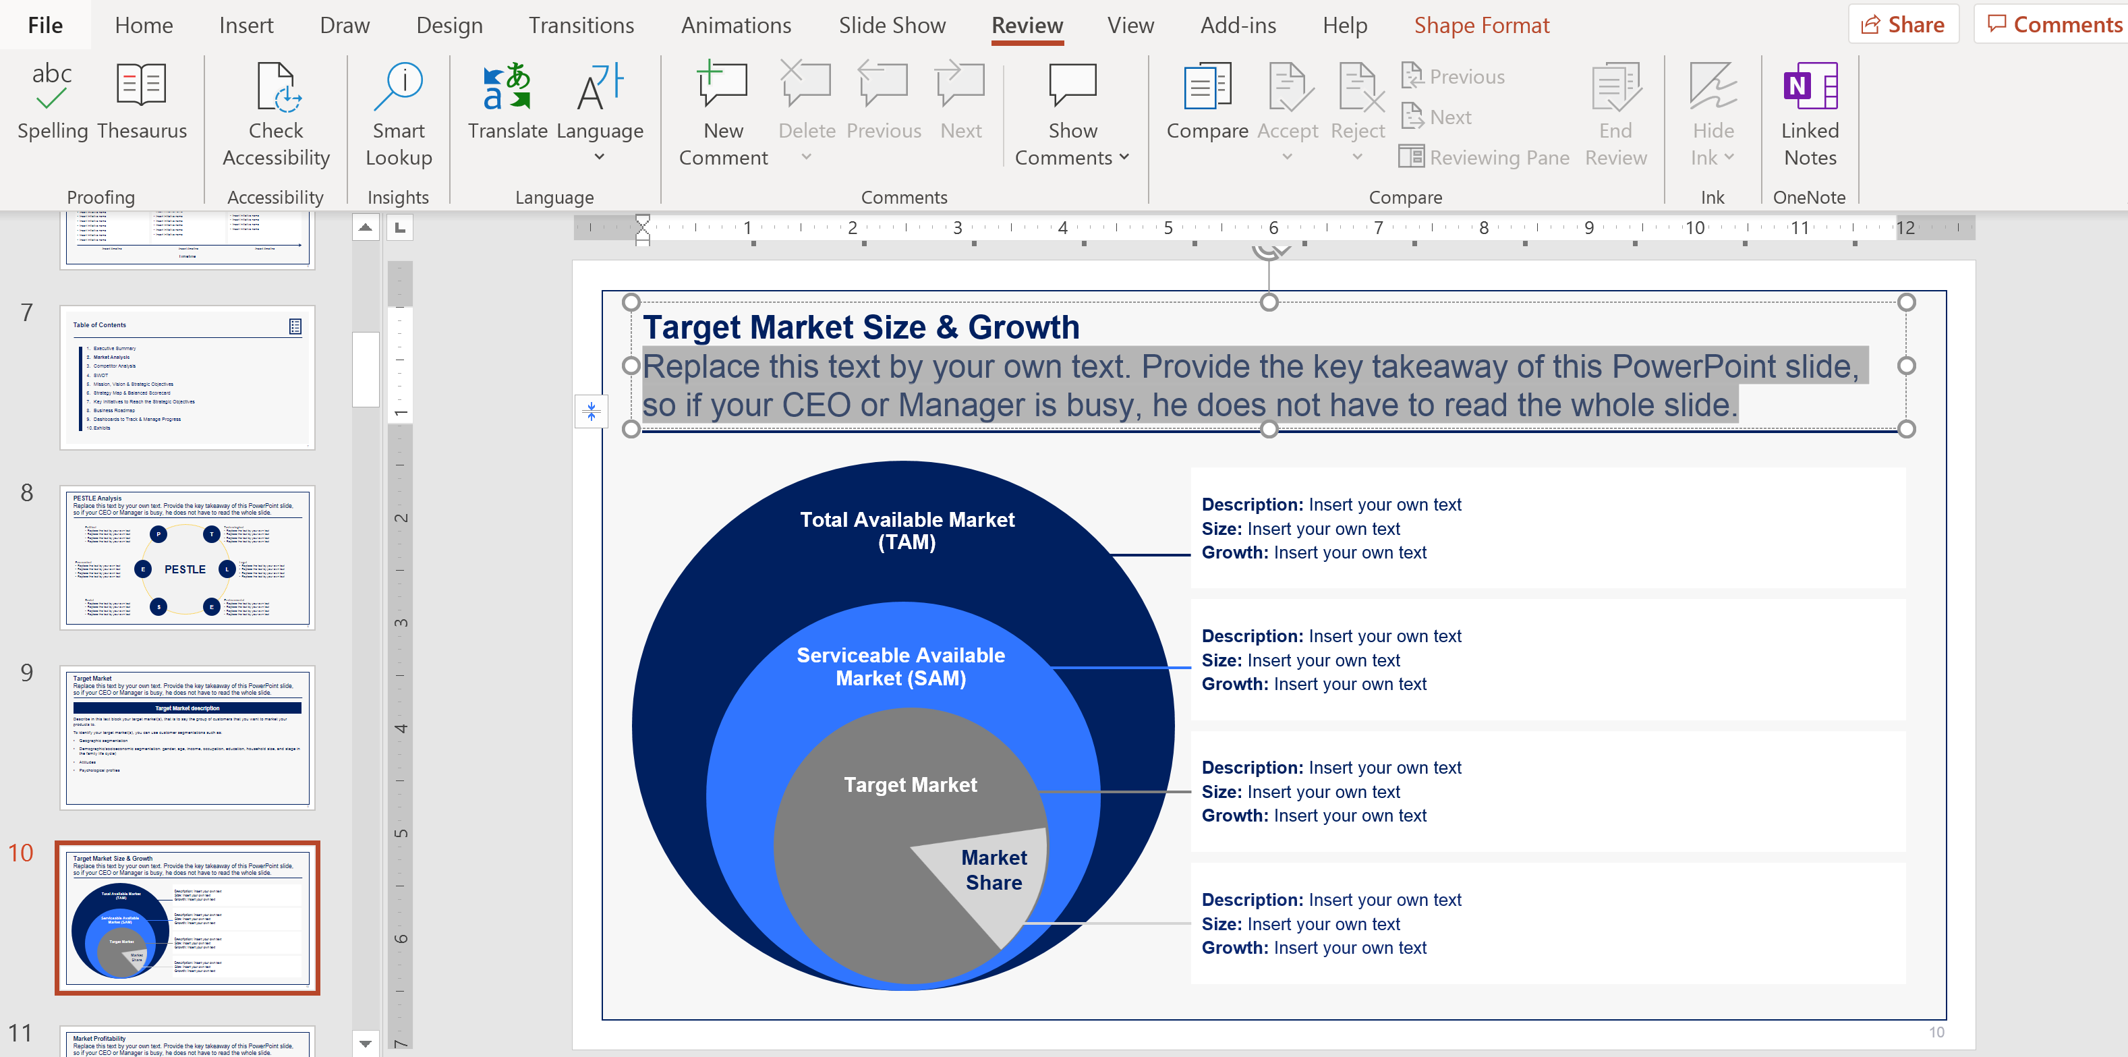
How to translate the Powerpoint version of our Toolkit Step 1
1
Open your Powerpoint document, select the text you want to translate and click on the “Review” tab

Slide 22
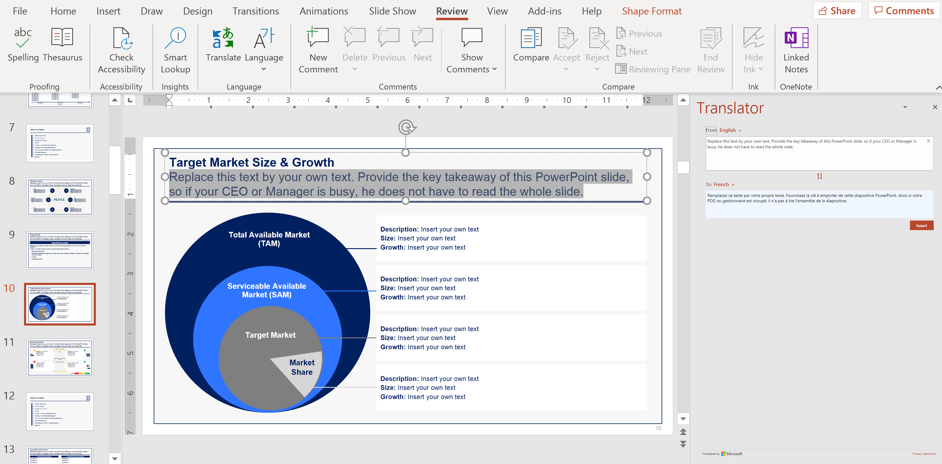
How to translate the Powerpoint version of our Toolkit Step 2
2
Click on “Translate”

Slide 23
How to translate the Powerpoint version of our Toolkit Step 3
3
Select the language you want the text to be translated into

Slide 24
How to translate the Powerpoint version of our Toolkit Step 1
4
Click “Insert” to replace the initial text with the translated text.

Slide 25
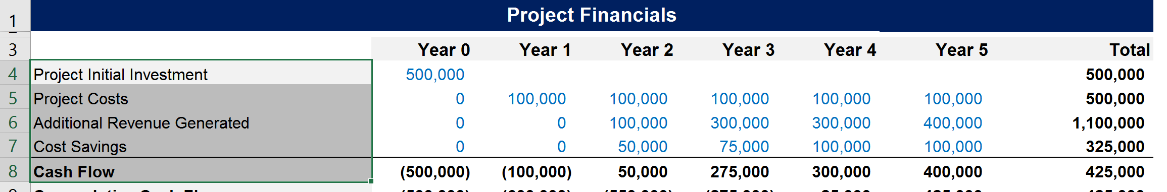
How to translate the Excel version of our Toolkit Step 1
1
Open your Excel document and select 1 cell or multiple cells in the same column

Slide 26
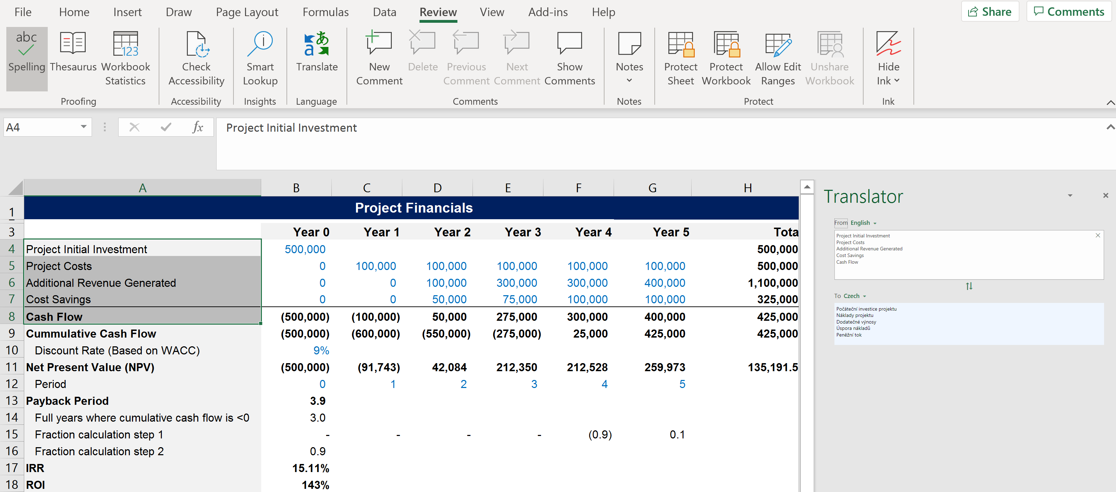
How to translate the Excel version of our Toolkit Step 2
2
Click on the “Review” tab and then “Translate”.

Slide 27
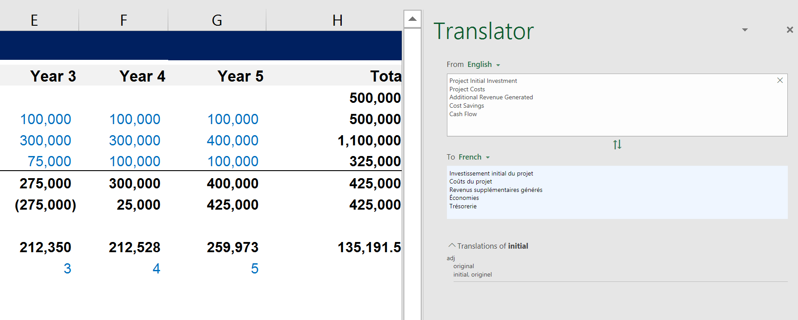
How to translate the Excel version of our Toolkit Step 3
3
Click inside the translated box and then select CTRL+A to select the entire translation, and CTRL+C to copy it

Slide 28
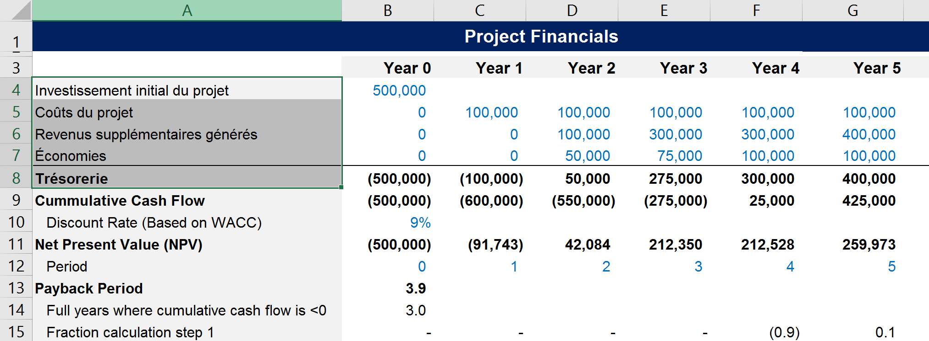
How to translate the Excel version of our Toolkit Step 4
4
Select where you want to paste your translation (in the example below, we decided to paste it exactly where the initial English text was). Then click on “Paste”, “Paste special” and “Text”. The 1 cell or multiple cells from the same column will be pasted using the same initial formatting

Slide 29

Thank you for your attention.
www.domontconsulting.com

